Slide 1
E6156 – Topics in SW Engineering: Cloud Computing
Lecture 4: REST, APIs, SSO, Events
© Donald F. Ferguson, 2022

Slide 2

Contents
2 | E6156 – Topics in SW Engineering: Lecture 4: APIs, REST, SSO, Events © Donald F. Ferguson, 2022

Slide 3
Agenda
Status and discussion.
A Good REST API, part I
Open API
Working/Hands On for Sprint 1

Slide 4
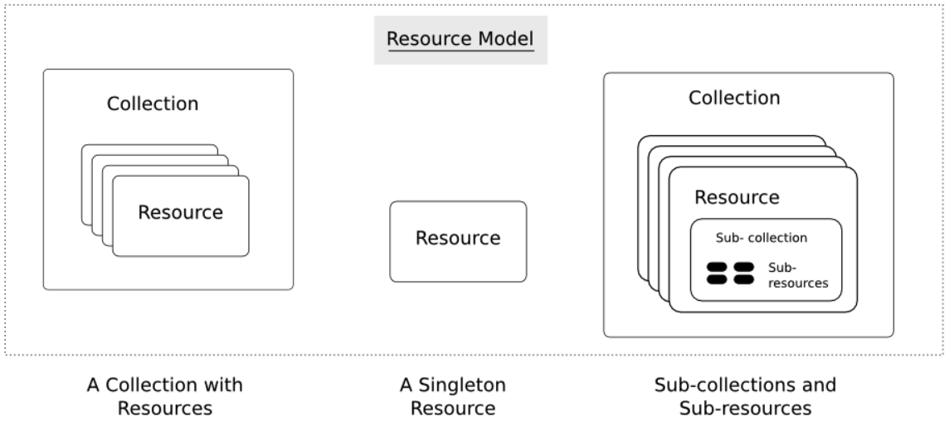

Slide 5
Status and Discussion
5 | E6156 – Topics in SW Engineering: Lecture 4: APIs, REST, SSO, Events © Donald F. Ferguson, 2022

Slide 6
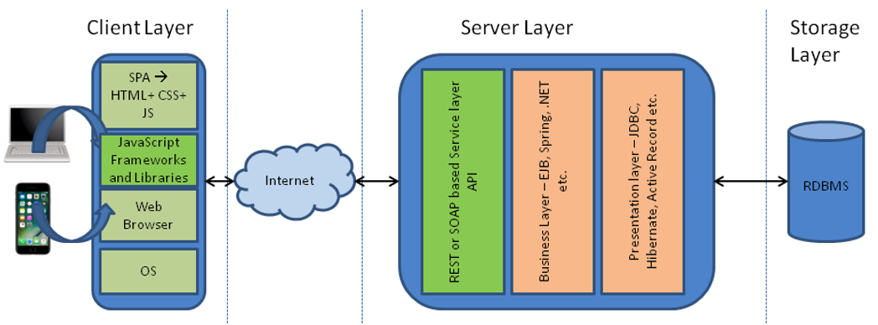
Simple Flask Application – Configuration
Possible configurations:
There are three “things:” web server, application server, DB server.
A “thing” can be on your laptop or on AWS.
You want your code to be the same and get information from the configuration.
One simple approach is environment variables for web application.
The angular application can use the URL because. Why would the cloud deployed angular application access your local web application.
Show code for environment variables and how to set environment variables.
Locally in PyCharm
On EC2 (.bash_profile)
Show use of URL in Typescript.
These approaches are “OK” but there are more secure approaches.
Also, remember to set security group rules properly.

Slide 7
Browser app …
Files
Typescript code
HTML, CSS
REST Endpoint
Paths
App logic with paths
DDL Schema
Integrity

Slide 8
Project Sprint 1
You are going to build 3 microservices. The exact ones you build will depend on the business/application problem you choose. Databases:
Use RDS. You can use one RDS instance with 3 separate databases.
This approach is not good, but will simplify things for you.
You will deploy the services picking one of the following for each. You must use both
EC2 – Directly on OS
Elastic Beanstalk
In a Docker container on an EC2 instance.
Simple web UI deployed in S3, behind CloudFront.
API gateway.
GitHub repositories and projects; Trello board.

Slide 9
Good REST API, Part I
9 | E6156 – Topics in SW Engineering: Lecture 4: APIs, REST, SSO, Events © Donald F. Ferguson, 2022

Slide 10

Status Codes and Linked Data
10 | E6156 – Topics in SW Engineering: Lecture 4: APIs, REST, SSO, Events © Donald F. Ferguson, 2022

Slide 11
REST (https://restfulapi.net/)
What is REST
REST is acronym for REpresentational State Transfer. It is architectural style for distributed hypermedia systems and was first presented by Roy Fielding in 2000 in his famous dissertation.
Like any other architectural style, REST also does have it’s own 6 guiding constraints which must be satisfied if an interface needs to be referred as RESTful. These principles are listed below.
Guiding Principles of REST
Client–server – By separating the user interface concerns from the data storage concerns, we improve the portability of the user interface across multiple platforms and improve scalability by simplifying the server components.
Stateless – Each request from client to server must contain all of the information necessary to understand the request, and cannot take advantage of any stored context on the server. Session state is therefore kept entirely on the client.
Cacheable – Cache constraints require that the data within a response to a request be implicitly or explicitly labeled as cacheable or non-cacheable. If a response is cacheable, then a client cache is given the right to reuse that response data for later, equivalent requests.
Uniform interface – By applying the software engineering principle of generality to the component interface, the overall system architecture is simplified and the visibility of interactions is improved. In order to obtain a uniform interface, multiple architectural constraints are needed to guide the behavior of components. REST is defined by four interface constraints: identification of resources; manipulation of resources through representations; self-descriptive messages; and, hypermedia as the engine of application state.
Layered system – The layered system style allows an architecture to be composed of hierarchical layers by constraining component behavior such that each component cannot “see” beyond the immediate layer with which they are interacting.
Code on demand (optional) – REST allows client functionality to be extended by downloading and executing code in the form of applets or scripts. This simplifies clients by reducing the number of features required to be pre-implemented.

Slide 12
REST Principles
What about all of those principles?
Client/Server
Stateless
Cacheable
Uniform Interface
Layered System
Code on demand
Some of these principles
Are simple and obvious.
Are subtle and have major implications.
Stateless can be baffling, but we will cover later.
We will go into the principles in later lectures, ... but first linked resources ... ...

Slide 13
Resources
Resources are an abstraction. The microservice maps to create things and actions.
“A resource-oriented API is generally modeled as a resource hierarchy, where each node is either a simple resource or a collection resource. For convenience, they are often called a resource and a collection, respectively.
A collection contains a list of resources of the same type. For example, a user has a collection of contacts.
A resource has some state and zero or more sub-resources. Each sub-resource can be either a simple resource or a collection resource.
For example, Gmail API has a collection of users, each user has a collection of messages, a collection of threads, a collection of labels, a profile resource, and several setting resources.
While there is some conceptual alignment between storage systems and REST APIs, a service with a resource-oriented API is not necessarily a database, and has enormous flexibility in how it interprets resources and methods. For example, creating a calendar event (resource) may create additional events for attendees, send email invitations to attendees, reserve conference rooms, and update video conference schedules. (Emphasis added) (https://cloud.google.com/apis/design/resources#resources)
https://restful-api-design.readthedocs.io/en/latest/resources.html

Slide 14
REST – Resource Oriented
When writing applications, we are used to writing functions or methods:
openAccount(last_name, first_name, tax_payer_id)
account.deposit(deposit_amount)
account.close()
We can create and implement whatever functions we need.
REST only allows four methods:
POST: Create a resource
GET: Retrieve a resource
PUT: Update a resource
DELETE: Delete a resource
That’s it. That’s all you get.
A REST client needs no prior knowledge about how to interact with any particular application or server beyond a generic understanding of hypermedia.
“The key characteristic of a resource-oriented API is that it emphasizes resources (data model) over the methods performed on the resources (functionality). A typical resource-oriented API exposes a large number of resources with a small number of methods.” (https://cloud.google.com/apis/design/resources)

Slide 15
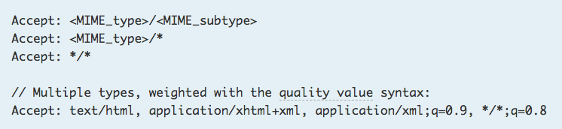
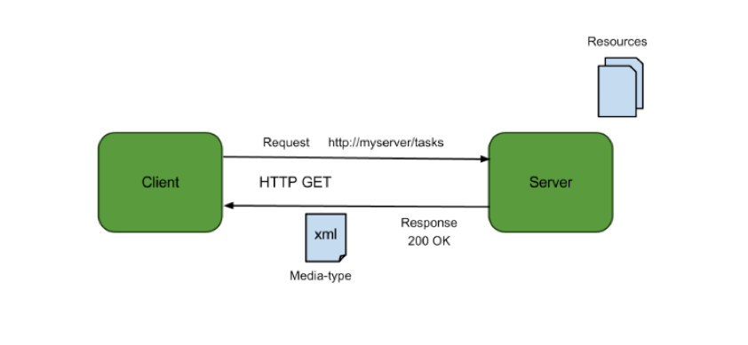
Resources, URLs, Content Types
Relative URL identifies “resource” on the server.
Server implementation maps abstract resource to tangible “thing,” file, DB row, … and any application logic.
Accept type in headers.
Client may be
Browser
Mobile device
Other REST Service
… …
Web media (content) type, e.g.
text/html
application/json

Slide 16
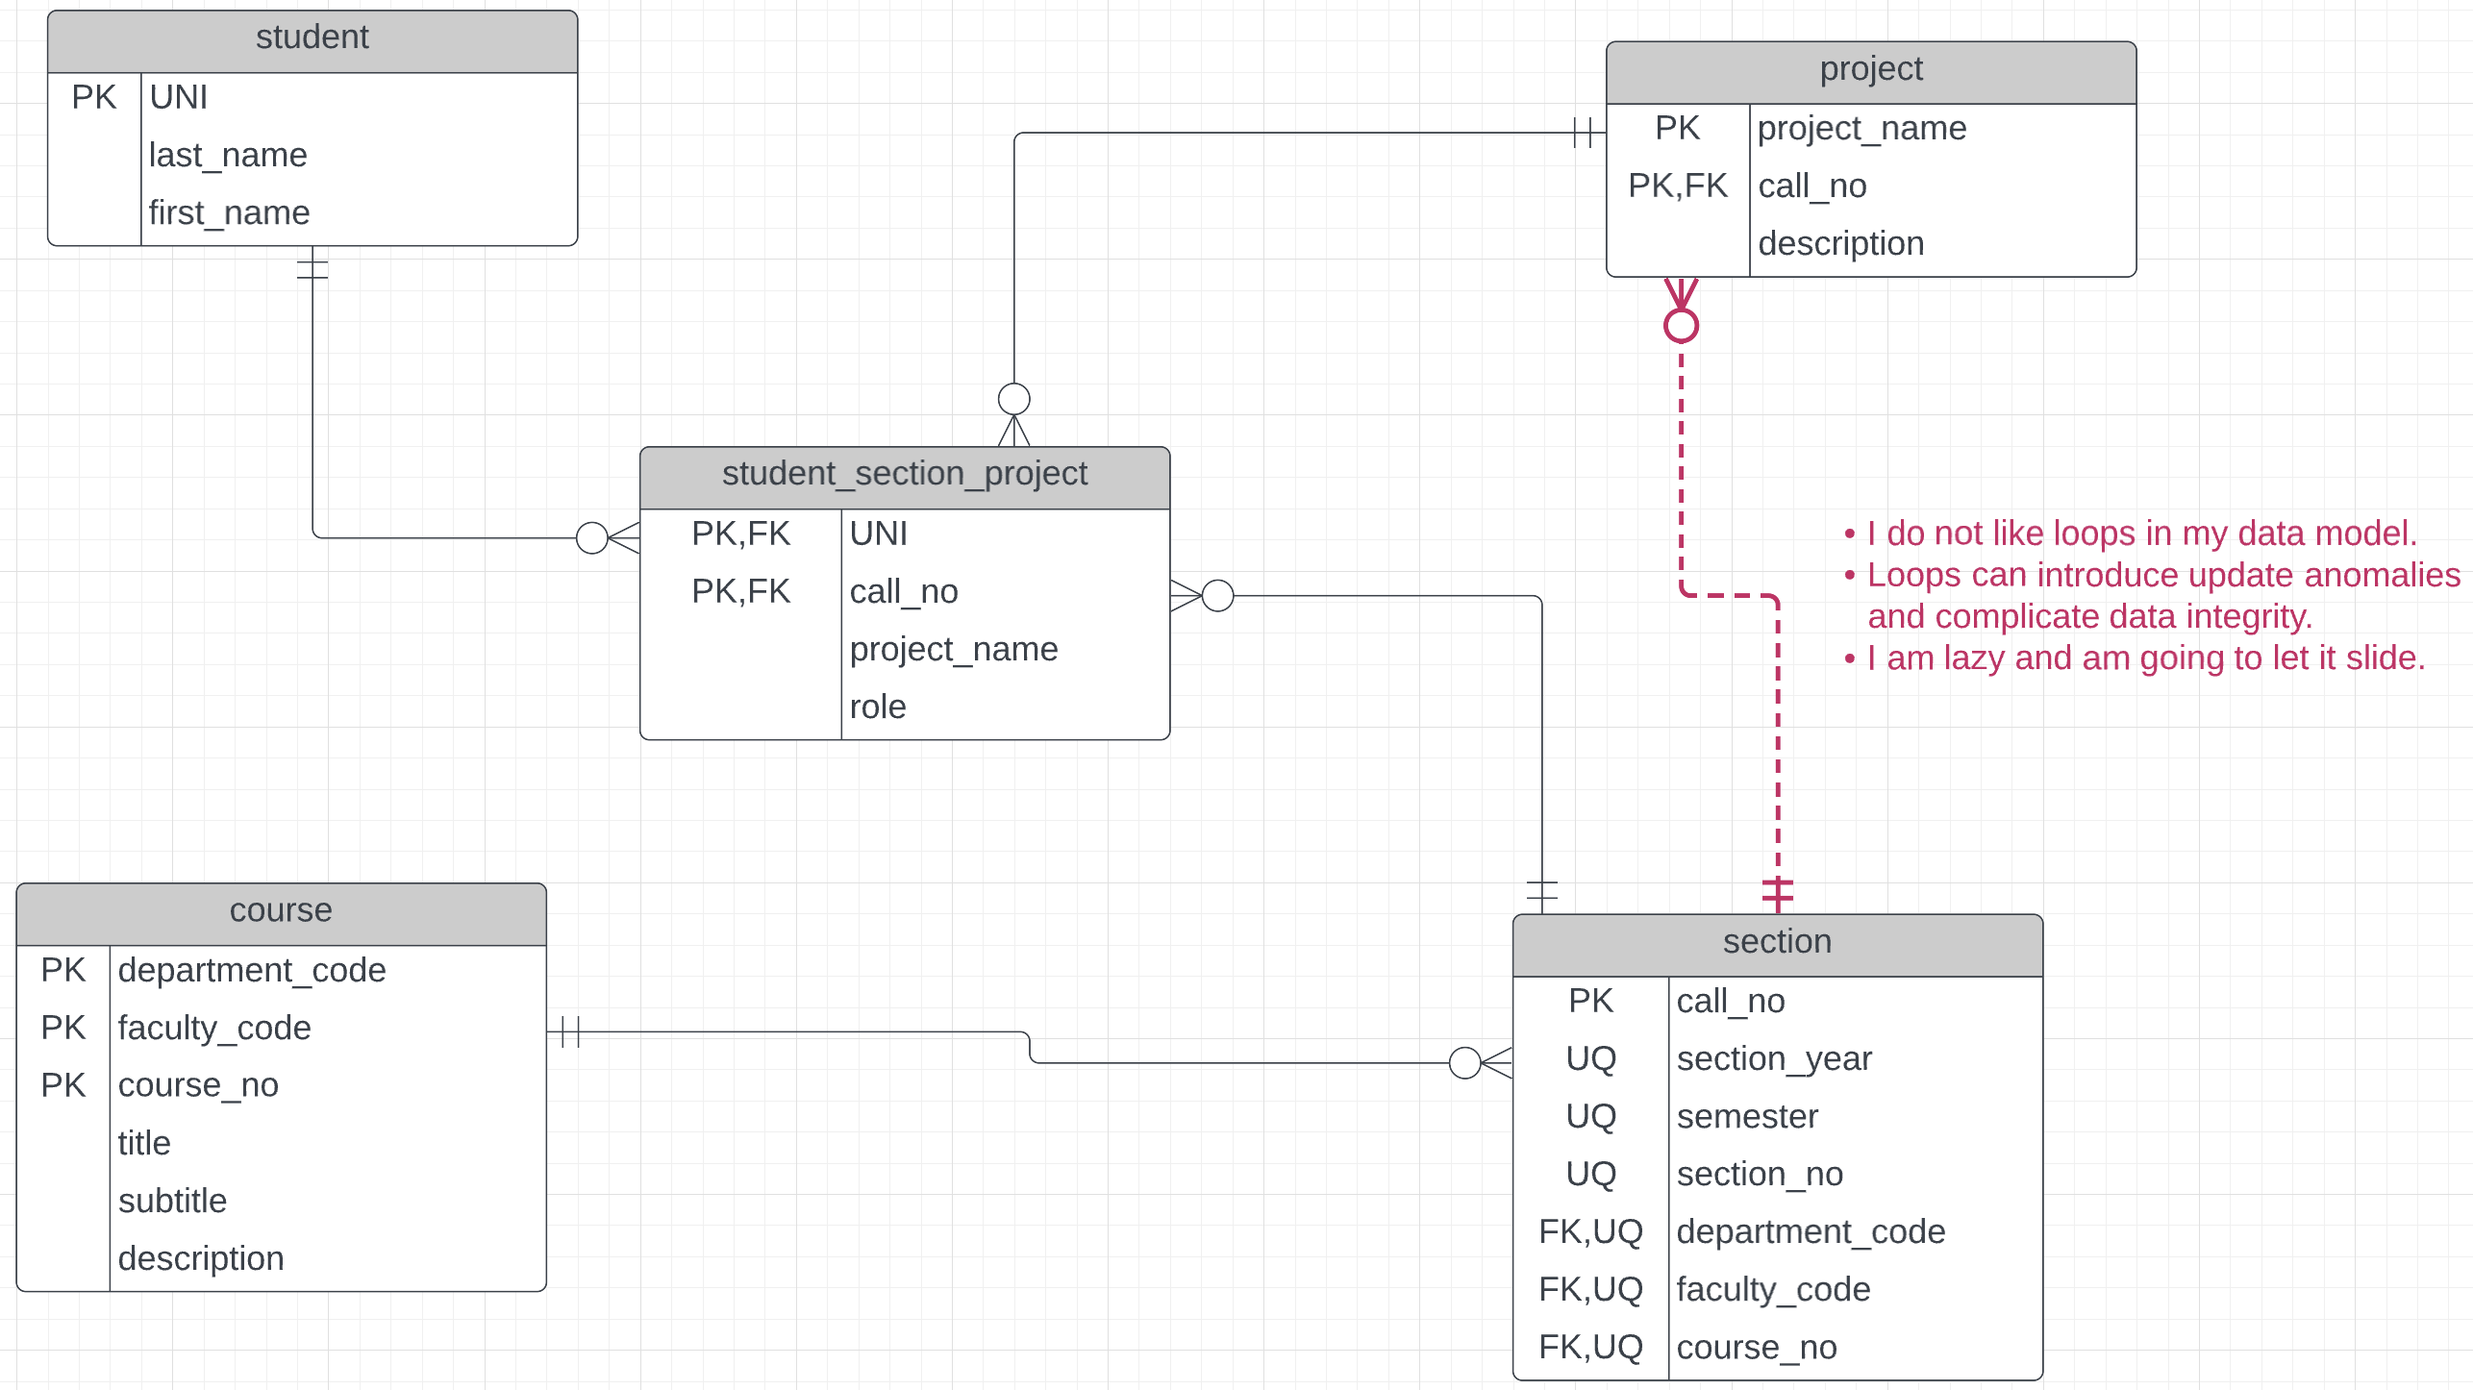
Simple Resource Model – First Attempt
The first paths the model implies are:
/api/students
/api/students/<uni>
/api/students/<uni>/enrollments. find_enrollments(uni=‘dff9’)
/api/enrollments?uni=dff9

Slide 17
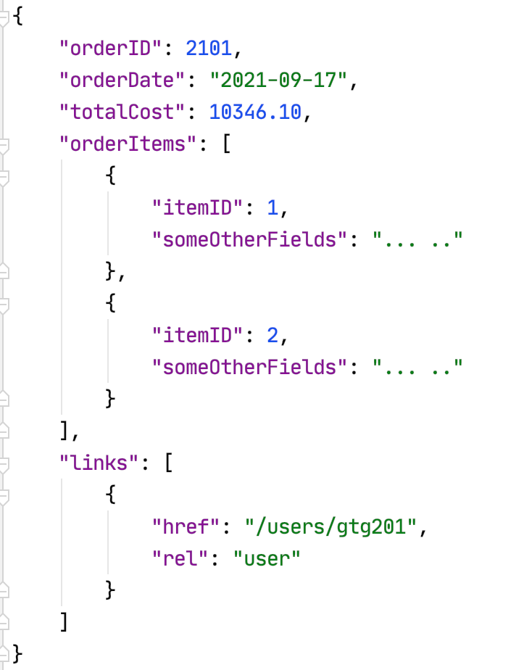
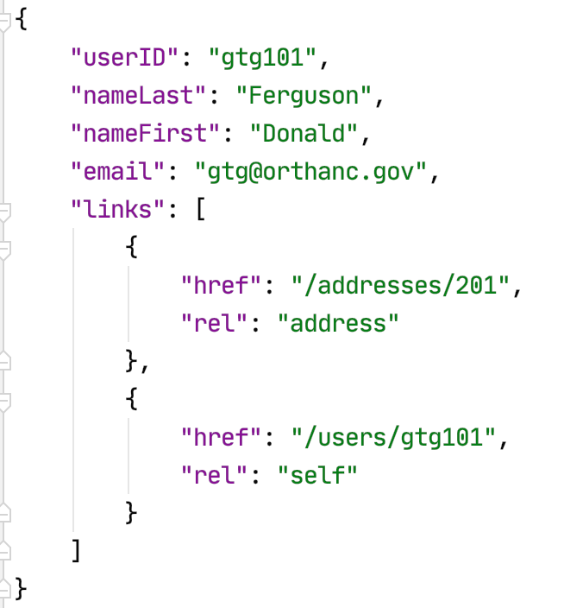
Resource Paths
The simple object model might/could/would/should have the following:
/users
/users/<userID>
/users/<userID>/address
/users/<userID>/orders
/addresses
/addresses/<addressID>/users
/orders/<orderID>
/orders/<orderID>/orderitems
/orders<orderID>/orderitems/<itemID>
... ...
How do you “point backwards” in a “foreign key relationship,” e.g. Address → User
“href” : “/users?addressID=201”
This means you store the addressID in the DB but return a link om REST.
Composition
Association

Slide 18
Status Codes and Linked Data
18 | E6156 – Topics in SW Engineering: Lecture 4: APIs, REST, SSO, Events © Donald F. Ferguson, 2022

Slide 19
Status Codes
Consider GET on /api/students/dff9
The two most common HTTP status codes would be:
200 – OK, which would also have a body, content type, … …
404 – NOT FOUND
If the application implements security (authentication, authorization), additional status codes could be:
401 – UNAUTHORIZED (caller needs to be logged on to access resource)
403 – FORBIDDEN (caller logged on but does not have permission to access resource)
The coolest status code is:
418 – I’m a teapot
The RFC (standard) specifies this code should be returned by teapots requested to brew coffee.

Slide 20
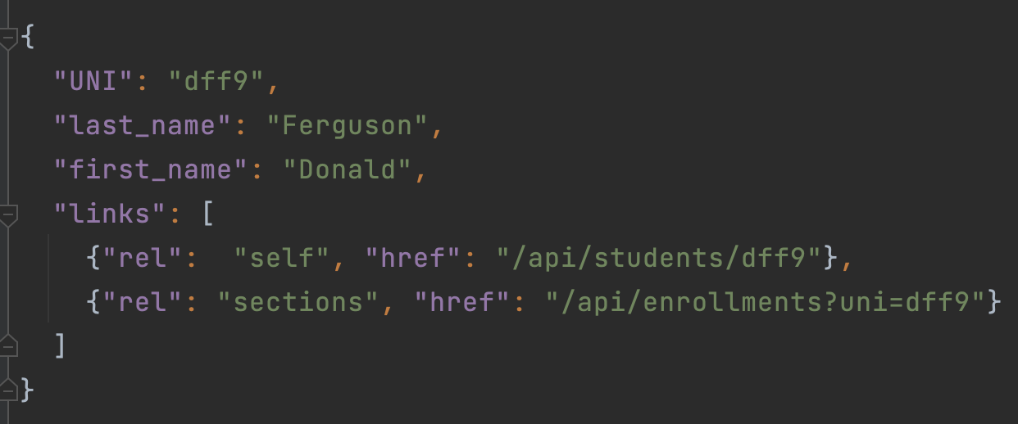
Body and Linked Data
I would need to read the documentation to know:
Students is related to enrollments.
That I use the UNI as a query string parameters.
… …
Not self-describing.
I cannot follow link like I can on an HTML page.
GET /api/students/dff9 returns the body:
The properties UNI, last_name, first_name are obvious.
The content-type would be application/json
The caller to navigate to two related resources using hyperlinks.
Without the links section, the interface would not comply with “self descriptive” and “identification of resources.” The caller would need “side knowledge” to know related resources and how to “identify” them.

Slide 21
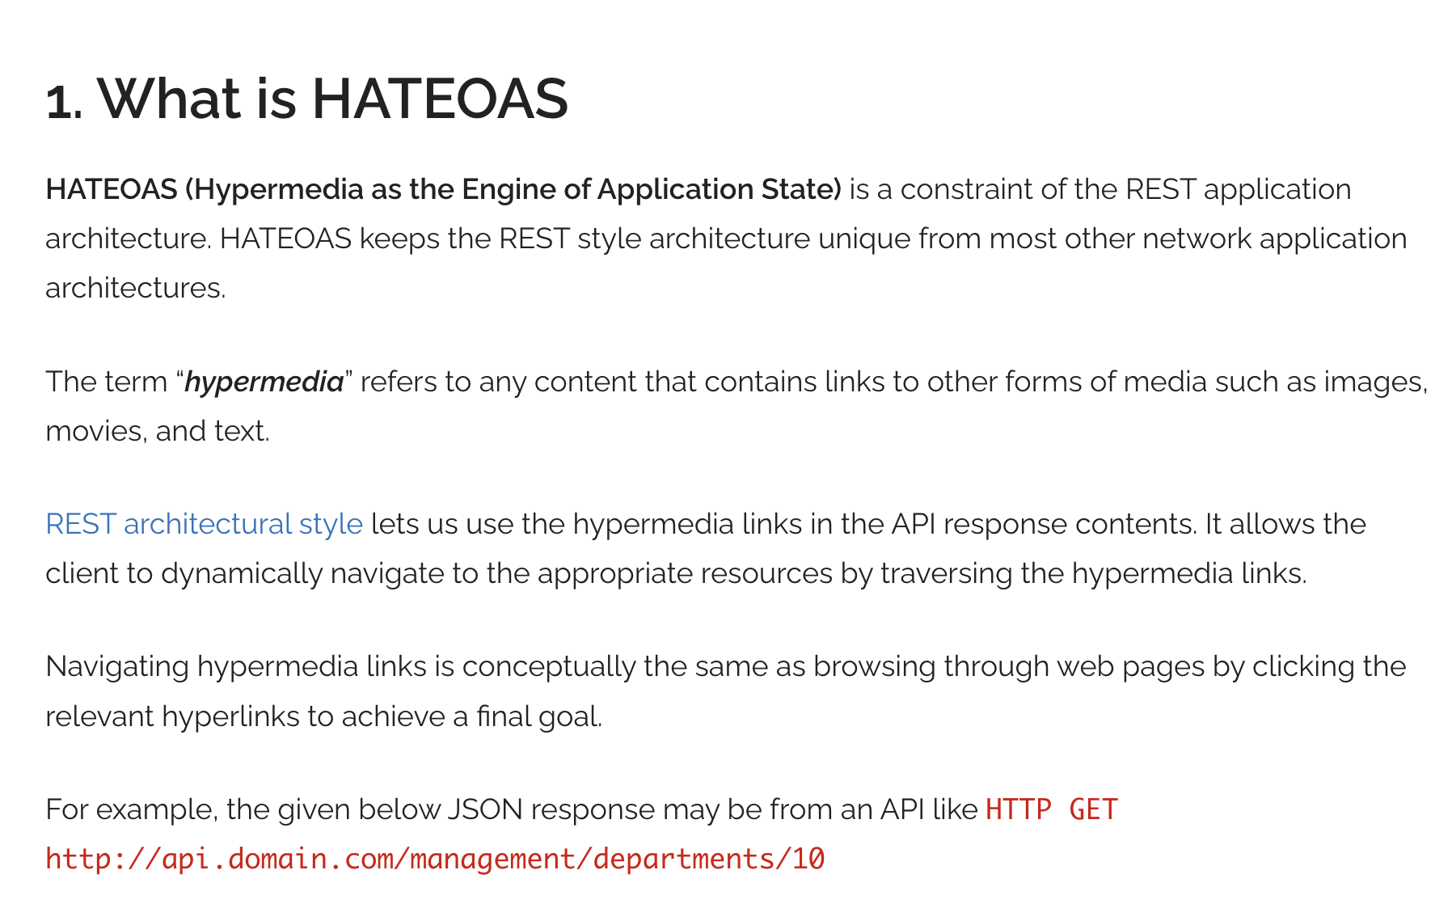
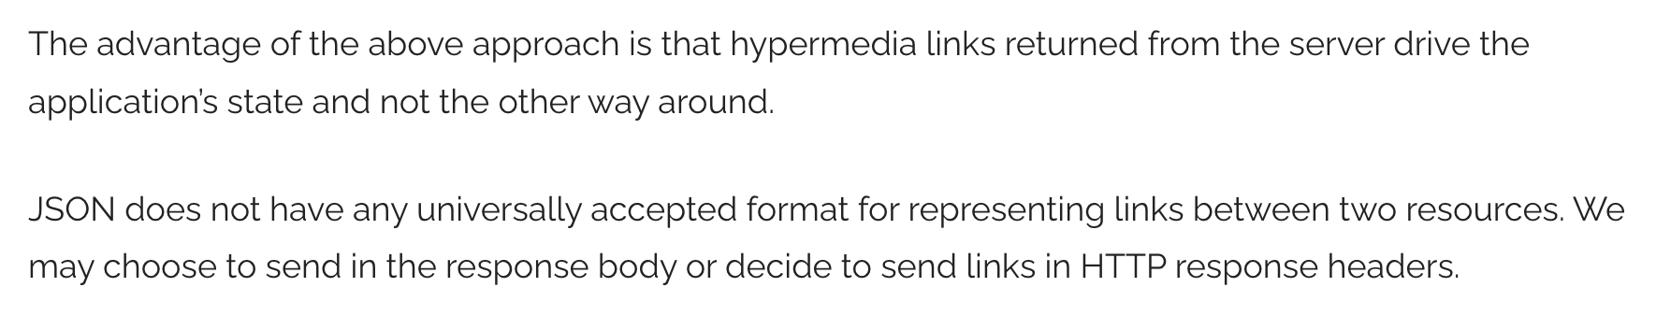
HATEOAS
https://restfulapi.net/hateoas/

Slide 22
Query
22 | E6156 – Topics in SW Engineering: Lecture 4: APIs, REST, SSO, Events © Donald F. Ferguson, 2022

Slide 23
Query Strings
What does the client application do it it does not know the “primary key?” The client can use a query string on the collection.
An example:
/api/students?last_name=Ferguson&first_name=Donald
Is analogous to the SQL query select * from students where last_name=‘Ferguson’ and first_name=‘Donald’
Unlike SQL, query strings only support
‘=‘ for comparison of resource property to a value
‘&’ for Boolean operators.
One design pattern is to use fields=x,y,x to indicate returning a subset of properties, e.g.
/api/students?last_name=Ferguson&first_name=Donald&fields=uni,last_name
Is analogous to the SQL query select uni, last_name from students where last_name=‘Ferguson’ and first_name=‘Donald’
Query strings are very simple, but useful for many scenarios.
There are more powerful, complete query languages, e.g. GraphQL. (https://en.wikipedia.org/wiki/GraphQL)
A query that does not return contained resources has status_code 200 with an empty data section. This mirrors the SQL model. An SQL query that does not return rows returns an empty table.

Slide 24
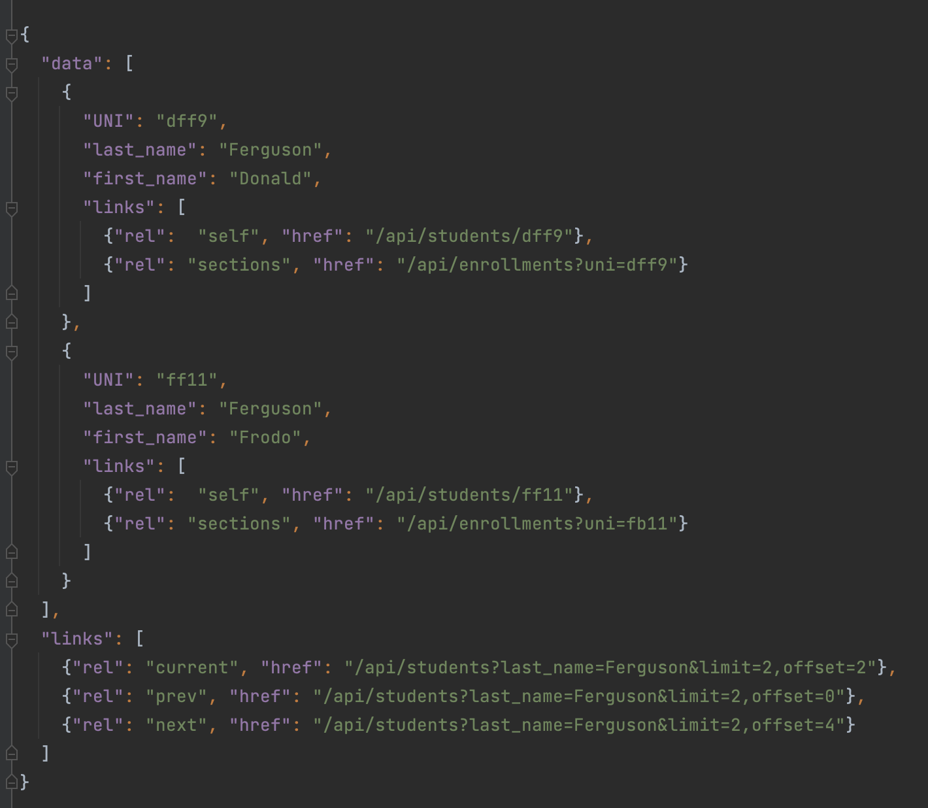
Pagination
Bad things may happen when a GET returns a huge result set.
A page is a window on the large result set.
limit is the no. of entries in the result set.
Client may specific a limit.
Server may have a default and/or maximum limit it allows.
There are many design patterns for implementing pagination.
Simplest is mirroring the SQL model:
limit=xxx&offset=yyy
The links section is the response should contain:
prev
next
current
May contain first and last.

Slide 25
Summary
25 | E6156 – Topics in SW Engineering: Lecture 4: APIs, REST, SSO, Events © Donald F. Ferguson, 2022

Slide 26
Summary and Progress
Path | Method | Description
/resource | POST | Create a new resource in collection. Similar to SQL INSERT.
 | GET | Retrieve all resources in a collection or query for a subset of the resources. Similar to SQL SELECT
/resource/<key> | GET | Get a specific resource in collection. Similar to finding by primary key.
 | PUT | Similar to SQL UPDATE
 | DELETE | Similar to SQL DELETE
/resource/key/<resource2> |  | Similar to following a foreign key relationship
We will cover other operations, subtleties, etc. in next lecture.
We will also cover other REST concepts like statelessness, … … in next lecture.

Slide 27
OpenAPI
27 | E6156 – Topics in SW Engineering: Lecture 4: APIs, REST, SSO, Events © Donald F. Ferguson, 2022

Slide 28
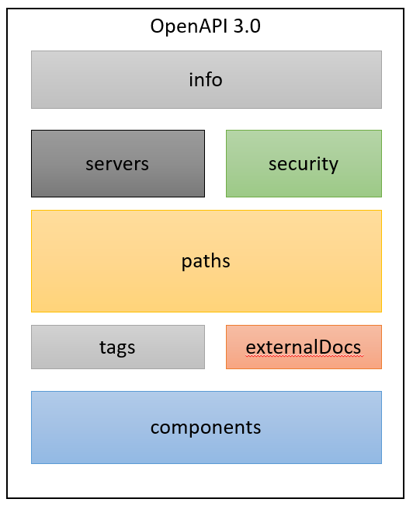
OpenAPI
The OpenAPI Specification, previously known as the Swagger Specification, is a specification for machine-readable interface files for describing, producing, consuming, and visualizing RESTful web services. (https://en.wikipedia.org/wiki/OpenAPI_Specification)
Sections:
Info: Basic information about API, e.g. author, license.
Servers: Endpoint addresses implementing API.
Security: Security protocols and providers supported
Paths:
Implicitly defines the “resource” and “navigation link” by enumerating paths.
Specifies parameters, return types, content types, etc.
Tags: Metadata for classifying/grouping paths.
External Docs links to additional information.
Components: Specifies body element schema. Logically defining:
Data Transfer Objects
Entity types in the ER-Model.
There are two basic approaches to defining the OpenAPI document:
Top-down: Explicitly author an OpenAPI document.
Bottom-up/Inside-out: Annotate implementation to define how to map application implementation elements to document.

Slide 29
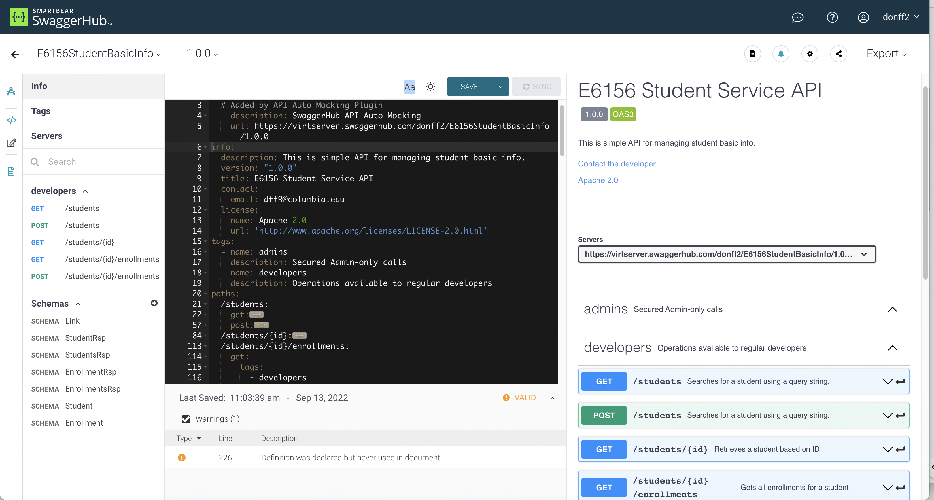
OpenAPI Document (https://app.swaggerhub.com/apis/donff2/E6156StudentBasicInfo/1.0.0#/info)

Slide 30
Working Session
30 | E6156 – Topics in SW Engineering: Lecture 4: APIs, REST, SSO, Events © Donald F. Ferguson, 2022

